Slide 1
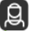
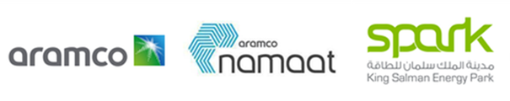
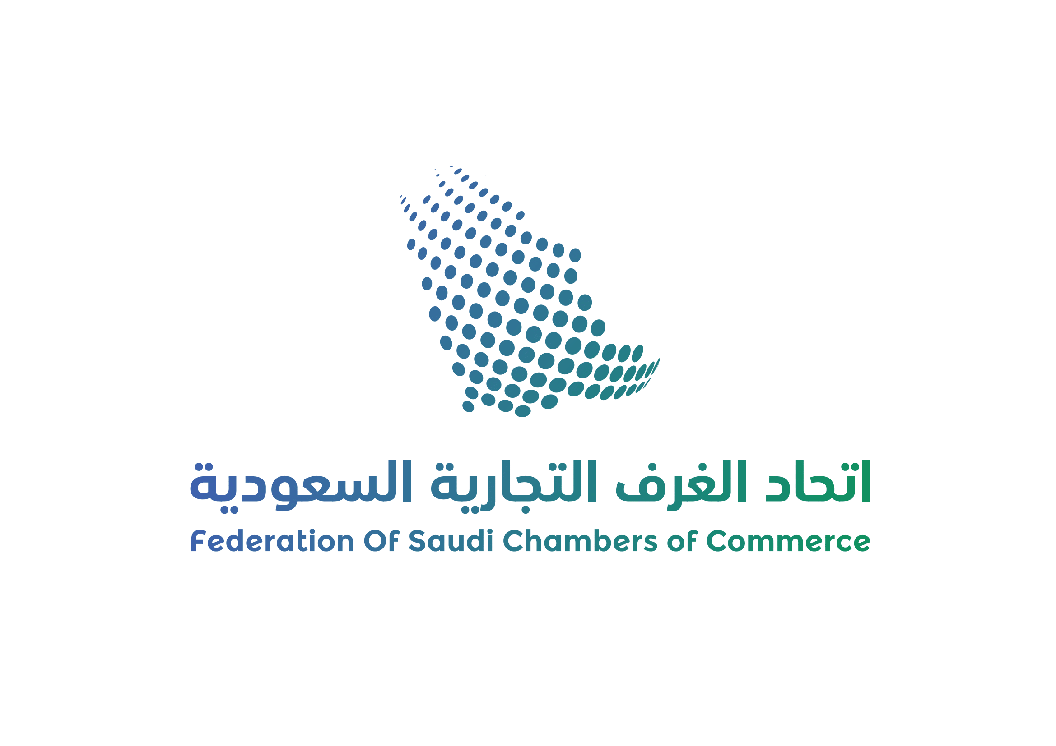

Join the
Saudi-Chinese Business Council (SCBC)
Join the Saudi-Chinese Business Council (SCBC) for an exclusive workshop introducing the
Digital Hub and Non-Metallic Hub at King Salman Energy Park (SPARK), Saudi Arabia’s rapidly growing industrial zone dedicated to advancing digital and non-metallic solutions in the energy sector and beyond.
Located in Saudi Arabia’s Eastern Province, a region renowned for its industrial innovation and energy resources, SPARK is strategically positioned at the heart of the global energy market. Developed and managed by Saudi Aramco, it offers unparalleled access to growth opportunities, supply chain efficiencies, and world-class industrial support services.
The Digital Hub and Non-Metallic Hub at SPARK are designed to localize and expand the use of advance solutions across various industries, fostering a sustainable ecosystem that supports manufacturing, research, innovation, and investment opportunities. These initiatives aligns with Saudi Arabia’s Vision 2030 goals to promote advanced solutions that enhance efficiency, durability, and sustainability across key sectors.
Key Focus Areas:
The Digital Hub is designed to enable industrial applications in but not limited to Instrumentation & Process Automation, Industrial Internet of Things (IIoT) , Communication & Computing, and Data Center equipment.
The Non-Metallic Hub is designed to focus on materials manufacturing to enable industrial applications including expansion of polymer-based composites, advanced coatings, and fiber-reinforced materials in energy and infrastructure projects.
Why Attend?
• Gain insights into the incentives, and infrastructure support available at SPARK’s Digital/
Non-metallic Hub.
• Explore strategic partnerships and investment opportunities within Saudi Arabia’s expanding digital/
non-metallic sector.
• Engage in a live Q&A session with SPARK experts to understand business potential in this fast-growing
industry.
We look forward to your participation in this insightful session, unlocking new business and investment opportunities in the non-metallics sector.
Speakers
Faisal Al-Ratrout
Sr. Industrial Investment Attraction
Naif Rushaidan
Sr. Industrial Investment Attraction
at King Salman Energy Park (SPARK)
at King Salman Energy Park (SPARK)
Ahmed AL-Hijji
Sr.Business Development Analyst
Al-Johara Alkhanaifer
Business Development Analyst
at Saudi Arabian Oil Company (Saudi Aramco)
at Saudi Arabian Oil Company (Saudi Aramco)

